Slide 1
Complex Numbers
Argand Diagram

Slide 2
How do games move?

Slide 3
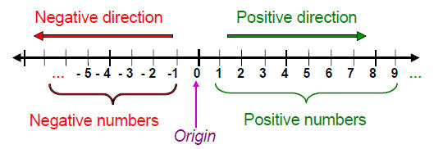
The Number Line – Real Numbers

Slide 4
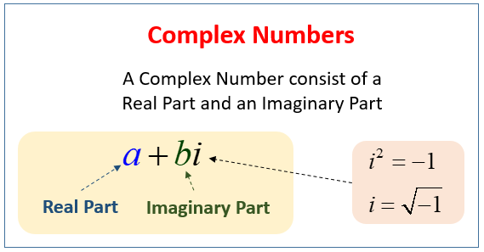
Complex Number – Real and Imaginary

Slide 5
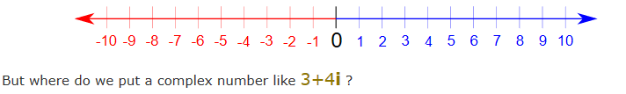
Do imaginary numbers fit on the line?

Slide 6
Argand Diagram
To show a Complex Number geometrically:
We will keep the Real part on the horizontal Number Line as usual.
We will add a new vertical axis for the Imaginary part.

Slide 7
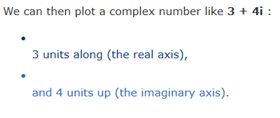
Argand Diagram
For the complex number 3 + 4i:
Real part on the horizontal axis.
Real Part = 3
Positive or Negative? Left or Right side?
Imaginary part on the vertical axis
Imaginary part = 4
Positive or Negative? Left or Right side?

Slide 8
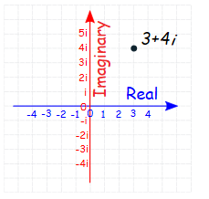

Slide 9
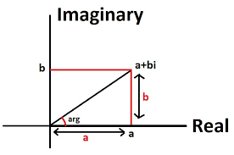
Argand Diagram

Slide 10


